Slide 1
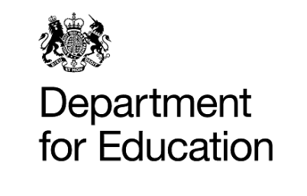
Understanding the Current DfE Landscape of Professional Development
Add your logo here
Notes:
The Approach to professional development has changed within the last year.
The presentation outlines the changes and implications in Lincolnshire.

Slide 2

What has changed in the last academic year?
750 Teaching Schools have ceased their designation from September 2021 onwards
Now a national network of 87 Teaching School Hubs
Every school in the country will have access to a centre of excellence for teacher professional development.

Slide 3
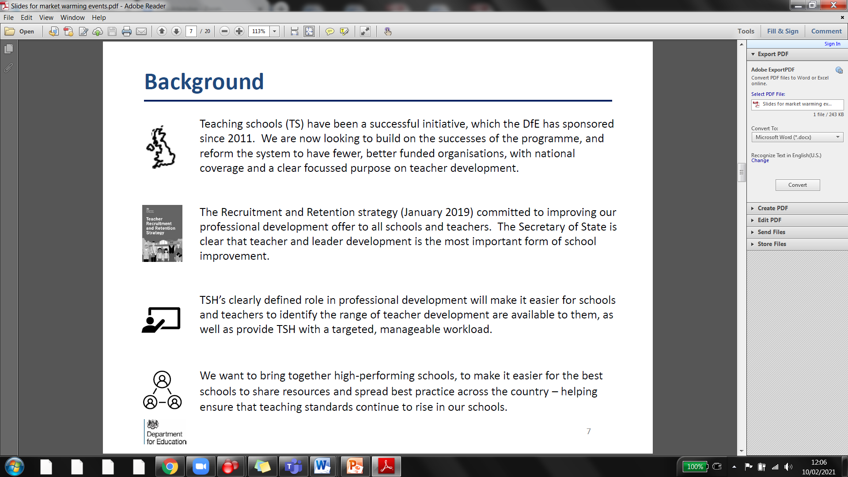
Why the Change?
Recruitment and Retention Strategy(2019)
“there are no great schools without great teachers. The key to education is the person at the front of the classroom. At a time when there are more pupils in our schools than ever before, we need to be attracting and keeping great people in teaching”
Ease for schools in accessing an offer which is quality assured and vetted, avoiding duplication and variation in quality
The opportunity for schools to benefit from the best expertise in the system, underpinned by research
Notes:
Reasons for the change
To focus on the retention of teachers
To focus on a simplified quality assured approach for schools
To identify the best research and expertise.

Slide 4
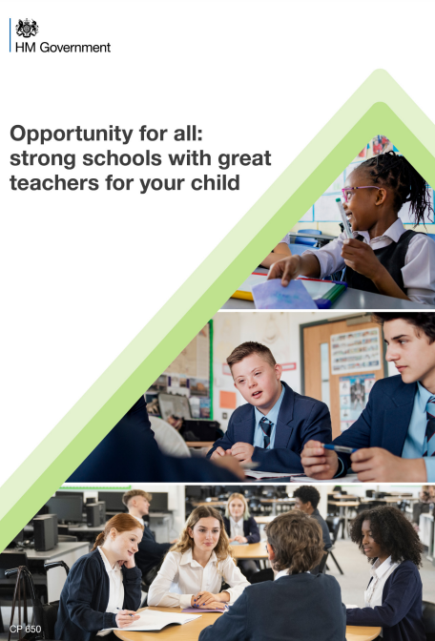
What is the White Paper saying?
1. We have established a national network of Teaching School Hubs, local centres of excellence in teacher development, to ensure that the benefits of these reforms deliver for teachers and pupils right across England.
2. Every Teaching School Hub will be involved in Initial Teacher Training to ensure that we have training places in every corner of the country.
3. Our dedicated English and maths hubs will support schools to drive up literacy and numeracy standards, continuing our emphasis on mastery and systematic synthetic phonics and publishing the second part of our reading framework in 2023.
4. From 2023, we will establish a network of modern foreign language hubs and introduce more effective continuous professional development courses for language teachers in both primary and secondary schools.
5. We have made progress in rolling out the Early Career Framework reforms and refreshed National Professional Qualifications. This guarantees every teacher a structured package of support during their first two full years in the classroom and provides a suite of training packages to support them as they progress in their career
Notes:
The White paper published 28th March 2022
What is this saying about Teaching School Hubs in the future…
https://assets.publishing.service.gov.uk/government/uploads/system/uploads/attachment_data/file/1063602/Opportunity_for_all_strong_schools_with_great_teachers_for_your_child__print_version_.pdf

Slide 5
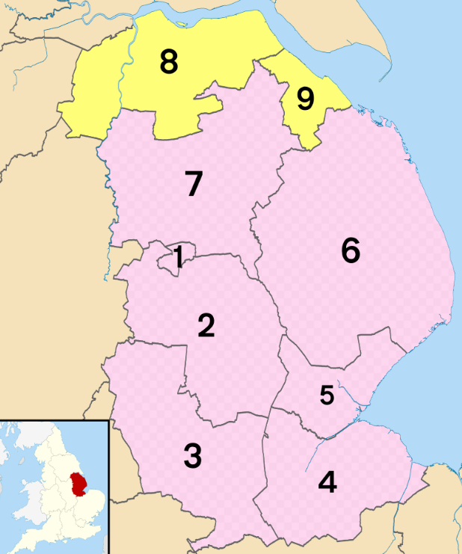

L.E.A.D. Teaching School Hub
1.Lincoln City
2. North Kesteven
3. South Kesteven
4. South Holland
5. Boston
6. East Lindsey
7. West Lindsey
Notes:
L.E.A.D. Teaching School Hub applied for the Hub and was awarded in September 2021 as the designated Hub for Lincolnshire.
The designation is for the next 6 years.
This is NOT a Teaching School as per the previous landscape, the responsibility and remit is entirely different. Detail to follow in the next few slides.
North and North East Lincolnshire (yellow sections- 8 and 9) has been awarded to the DRET Teaching School Hub.

Slide 6
L.E.A.D. Teaching School Hub is designated to work with all Schools across Lincolnshire
Type | Number of Schools
Total number of schools | 365
Primary | 280
Secondary | 53
Nursery | 5
Alternative provision | 6
Special | 19
Small Schools (under 100 pupils) | 97
Rural Deprivation ( In a village or hamlet) | 181
Urban ( In a town or city) | 184
Coastal ( 10 miles from the coast) | 81 Primary /15 Secondary = 96
Top 30% centile for Pupil Premium Data | 103
Notes:
What does this mean….
This is the demographic of Lincolnshire
The Hub is not based upon membership/an alliance – all schools across Lincolnshire are a part of the Teaching School Hub by virtue of being in Lincolnshire – this is not a subscription model but a service for all providing Quality Assured Professional Development for schools of all phases
Not in competition with any other organisations
Designated across all schools of all types

Slide 7
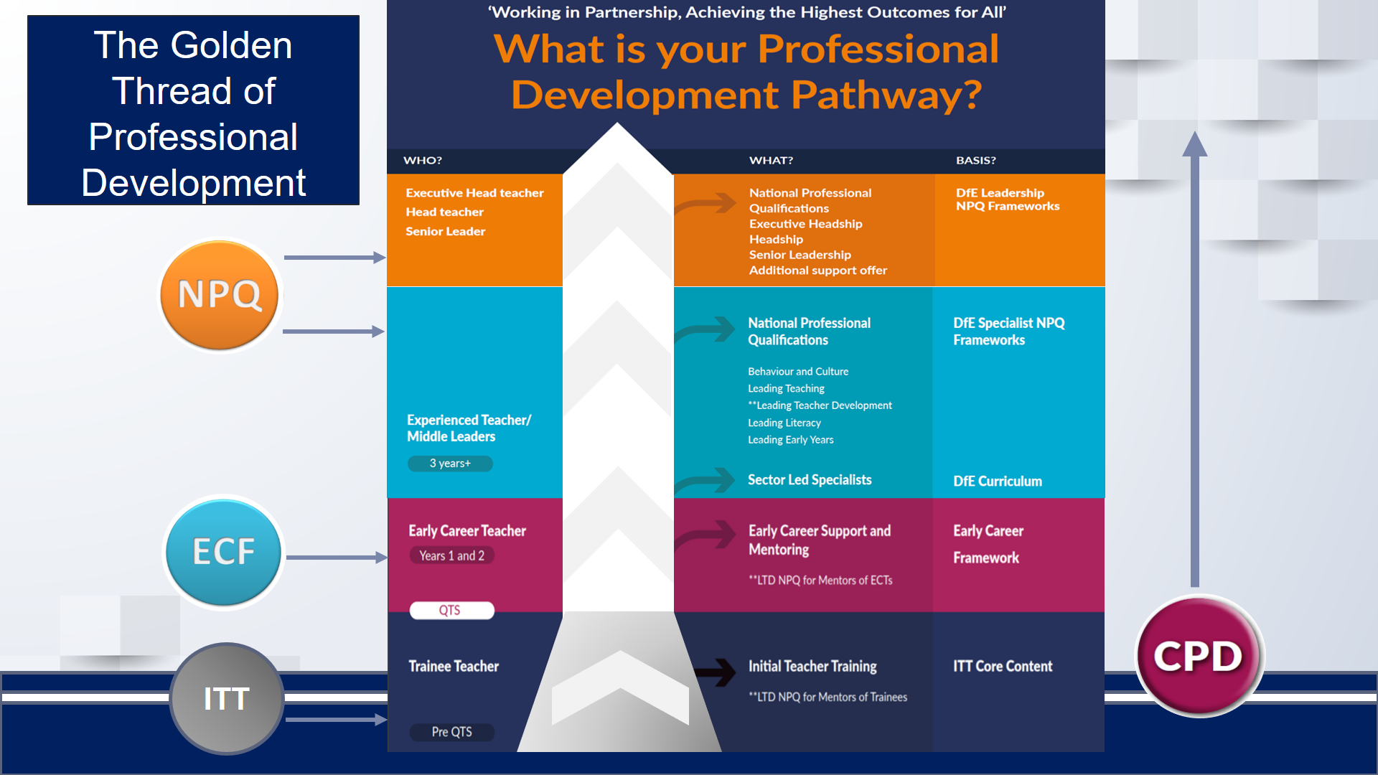
1.
TRANSITION HEADLINE
Let’s start with the first set of slides
Notes:
What is the role of the Hub?
Role is to provide a consistent quality assured approach to professional development.
This is from ITT to Early Career Framework for two years, through to Middle Leadership and the specialist NPQs and on into senior leadership , headship and eventually through to Executive Leadership
The golden thread of support provides CPD for teachers throughout their career, ensuring they are nurtured and developed at every stage, with the intention of retaining teachers in the profession
All CPD offered by the Teaching School Hub is in line with the policy of all individual curriculum hubs to ensure there is no duplicate in offer and therefore making the landscape simpler to follow for all HTs

Slide 8
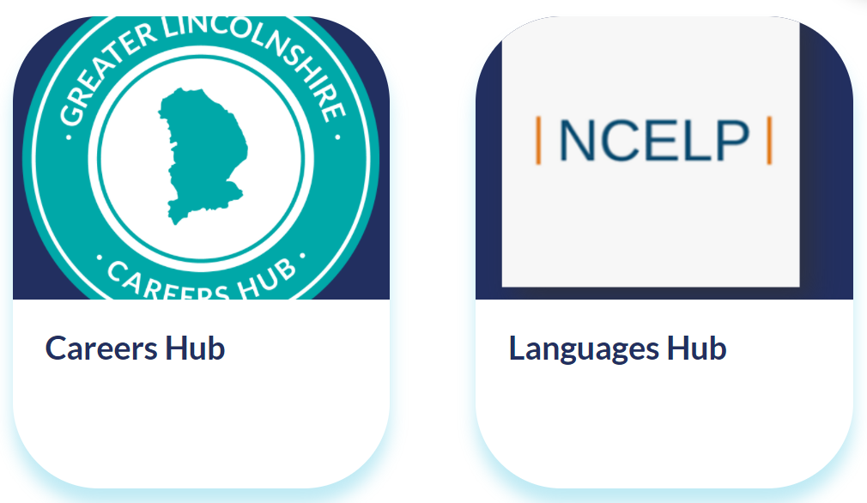
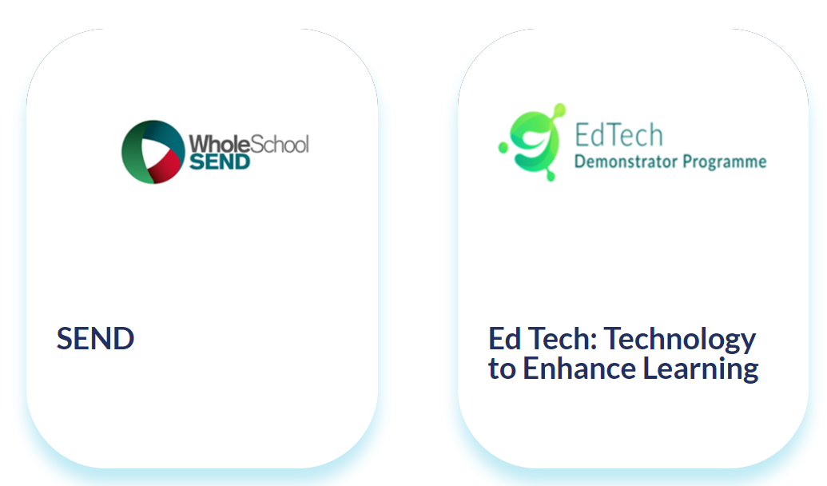
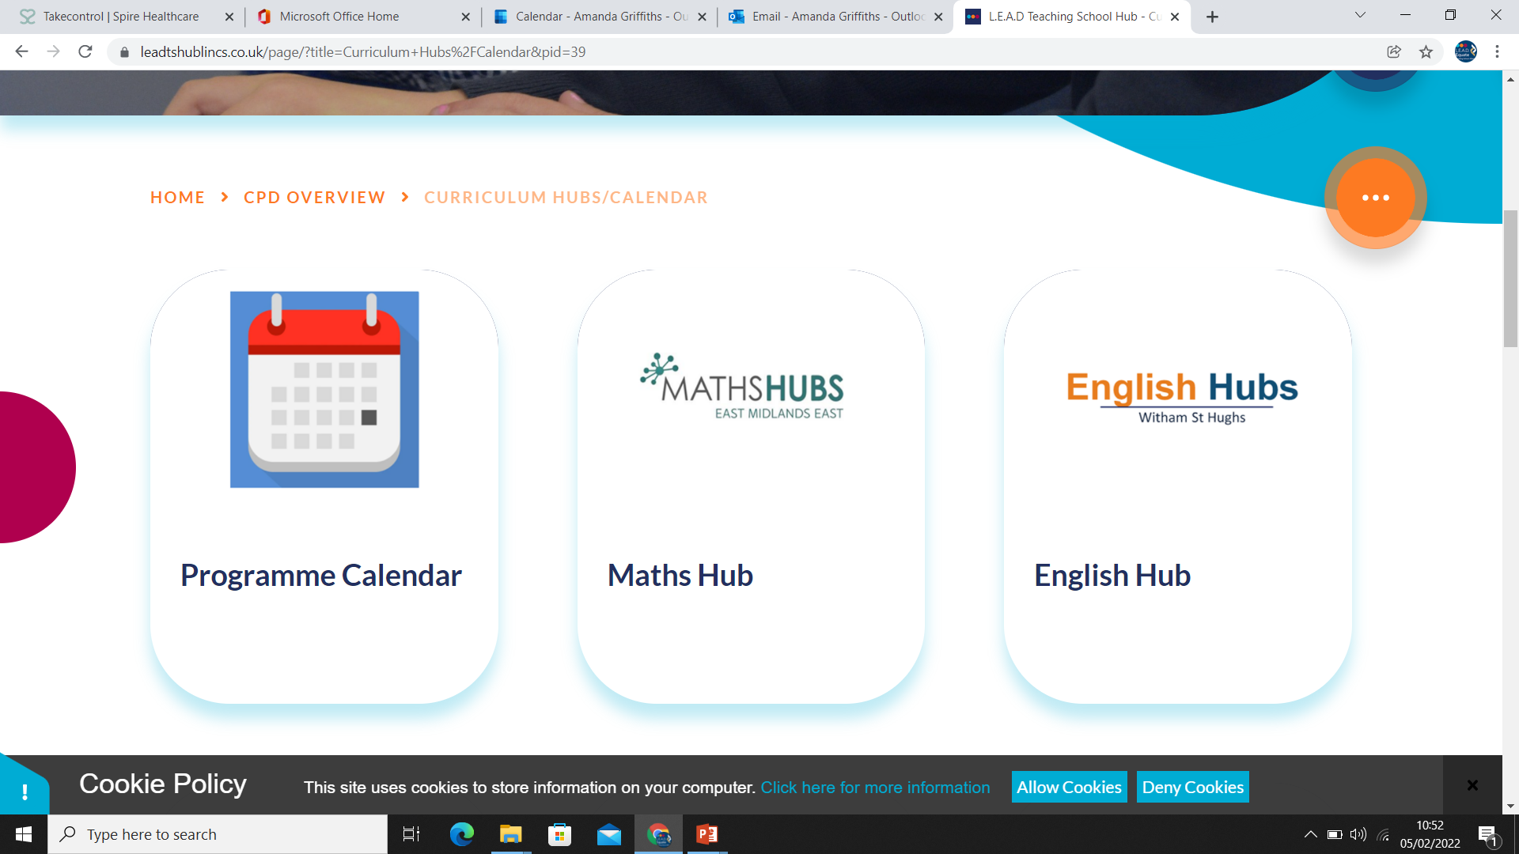
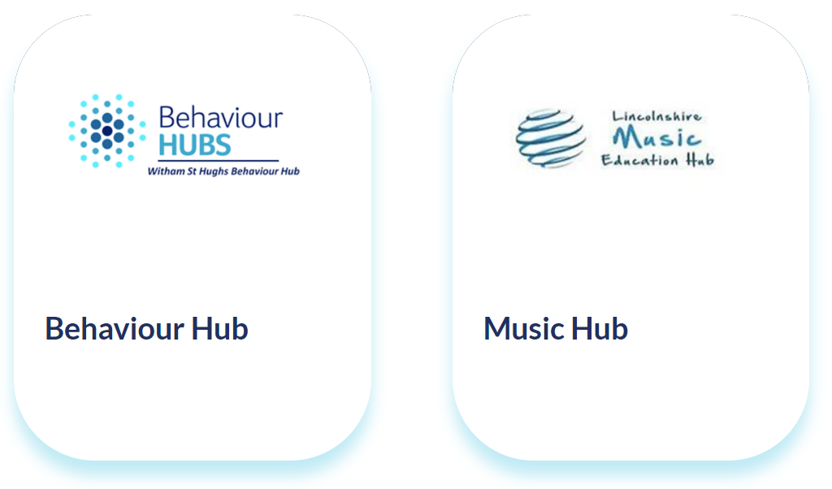
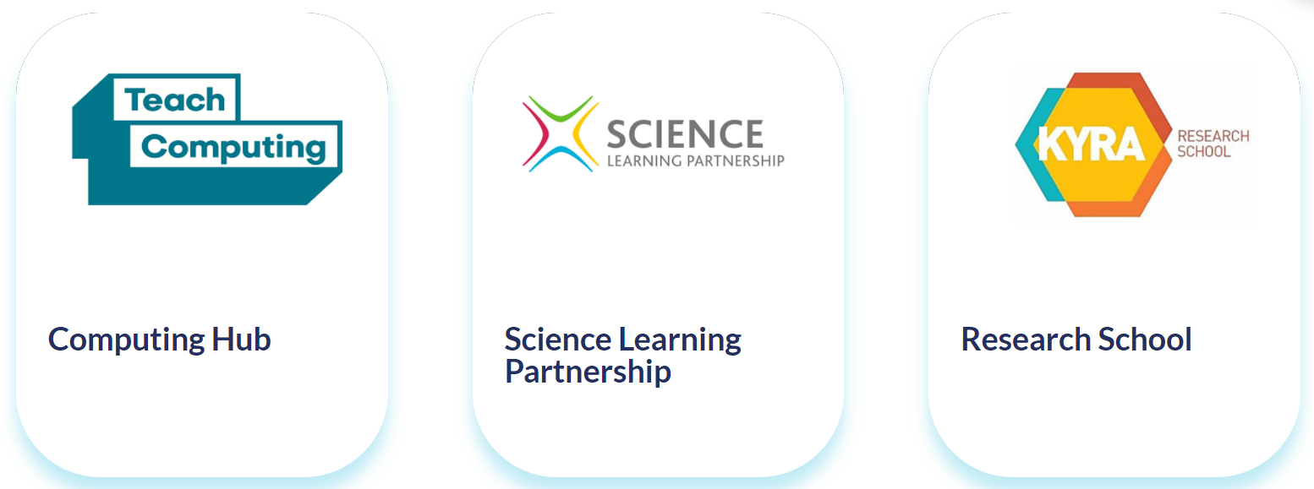
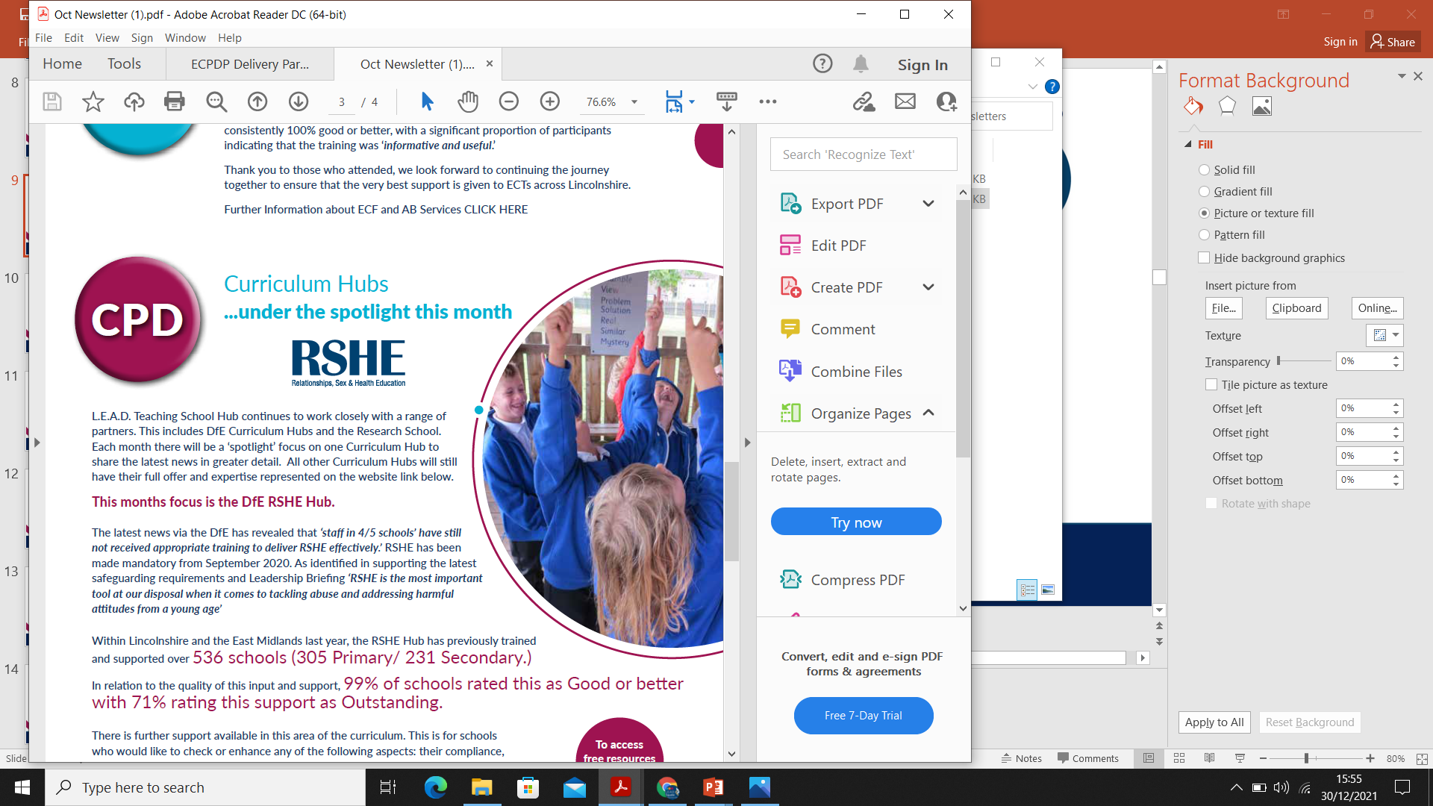

Curriculum Hubs
Notes:
Curriculum Hubs are vital in this landscape
DfE approved-
Funding available through many
The curriculum hubs are recommended to be the first option for support in these aspects of the Curriculum
https://www.leadtshublincs.co.uk/page/?title=Curriculum+Hubs%2FCalendar&pid=39.

Slide 9

Notes:
Essentially the Hub is free, reduced or discounted prices due to DfE funding and scale.
Funding available to schools via many Curriculum Hubs
It is for all schools across the county.
No subscription

Slide 10


Early Career Framework and AB Services
The early career framework (ECF) is a funded entitlement to a structured 2-year package of high-quality professional development.
Support and guidance
Quality Assurance
High quality face to face training- Mentors and ECTs
Online materials
Half termly AB meetings for support/ learning
Notes:
ECF (Early Career Framework) Free to schools
Access to a portal with materials for developing ECTs
Face to face training and support from local specialists
Funding for schools to release mentors
More Information: https://www.leadtshublincs.co.uk/page/?title=Early+Career+Framework+%28ECF%29&pid=16

Slide 11

National Professional Qualifications: FREE
NPQEL: Executive Headship
NPQH: Headship
NPQSL: Senior Leadership
New to Headship
Leadership
NPQLTD: Leading Teacher Development
NPQLBC: Behaviour and Culture
NPQLT: Leading Teaching
Specialist
NPQ Early Years and NPQ Leading Literacy being developed for September 2022
‘Working in partnership, achieving the highest outcomes for all’
Notes:
NPQs are free for the next 2 years.
Feedback has been 100% good and 60% exceptional from participants so far.
Strategic Planning in staff development to allow access to these qualifications is advised.
More information:
https://www.leadtshublincs.co.uk/page/?title=NPQ+Programmes&pid=23

Slide 12



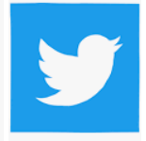
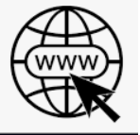

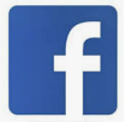
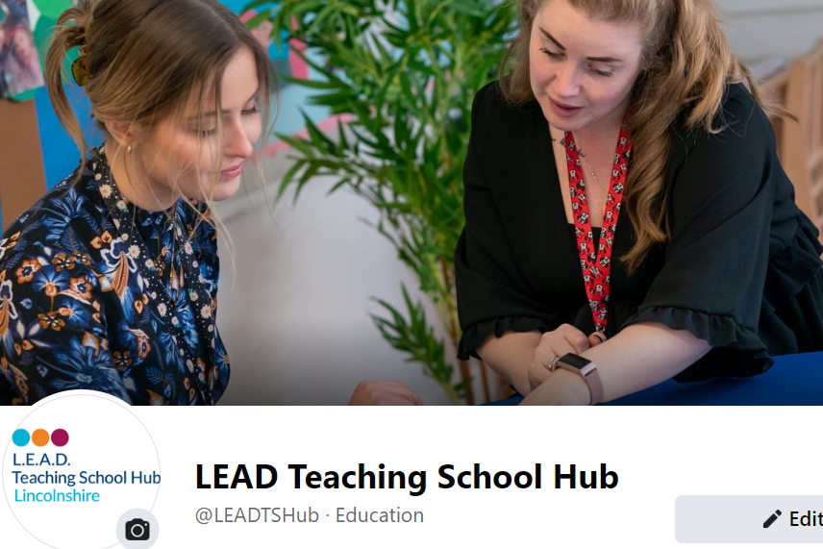
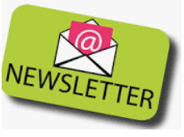
‘One Front Door’ for Professional Development’
Notes:
The Teaching School Hub aims to be the one front door for schools so that they can:
Source CPD easily
Be confident in knowing that the CPD is quality assured and value for money
Access the latest DfE messages from the Curriculum Hubs

Slide 13



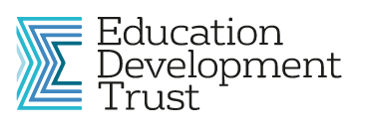


Quality Assurance is Statutory/Mandatory
Notes:
QA sets the Hub apart from the previous landscape.
The Lead providers are subject to Ofsted inspections for NPQ and ECF which in turn will involve the Hub
The Hub has rigorous processes of Quality Assurance for ECF/NPQ and CPD. This involves an externally appointed QA team and QA from other Hubs nationally.

Slide 14
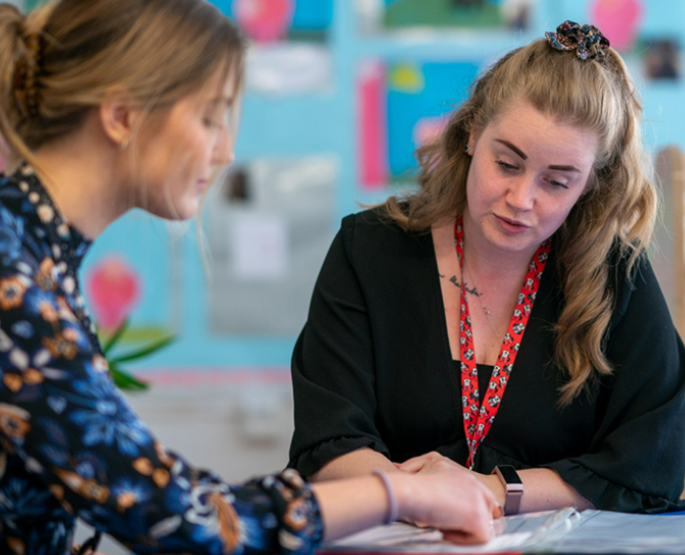


Why?
Notes:
Focus on teacher and leaders to impact upon pupils.
Aiming High to ensure teacher and leader/pupil development.
Further video of the Teaching School Hub if necessary: https://vimeo.com/engaginge/review/693639697/a4564f59a5

Slide 15

What does this mean for your school?
Reassurance that Professional Development is Quality Assured and value for money.
An opportunity to recruit and retain teachers in the profession.
A strategic approach to Professional Development for all staff that leaders and Governors can plan for and track.
Providing a “One Front Door” approach to CPD for schools – a simpler model for leaders to follow.
An opportunity for all staff to specialise and develop at every stage of their career
An opportunity for all schools within Lincolnshire to feel part of a community – with smaller support networks available according to phase / district.
Notes:
Focus on teacher and leaders to impact upon pupils.
Aiming High to ensure teacher and leader/pupil development.
Further video of the Teaching School Hub if necessary: https://vimeo.com/engaginge/review/693639697/a4564f59a5

