Slide 1
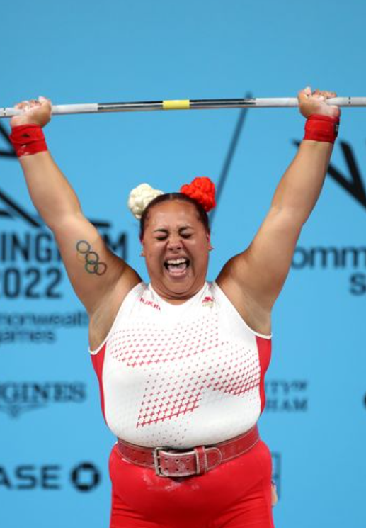
Emily Campbell
Protected characteristic:
Who they are
Emily Campbell is a 28 year old weightlifter from Bulwell, Nottingham who won a Commonwealth gold at the 2022 games in Birmingham. Emily was victorious in the women’s +87kg category as she set a new personal best and games record of 124kg in the snatch portion of the event. At the 2020 Summer Olympics in Tokyo (held in 2021 due to the COVID-19 pandemic), Campbell became the first British female weightlifter to win a medal at the Olympics, with a silver.
Why they were studied:
Emily breaks stereotypes around weightlifting and is also a great example of someone from Nottingham going on to achieve great things.
Studied as part of:
Looking at local role models/challenging gender stereotypes in sport.
Age | Pregnancy /maternity | Sexual orientation | Race | Gender reassignment | Sex | Disability | Religion/ belief | Marriage/civil partnership
 |  |  | x |  | x

