Slide 1
Why this work matters…
Children’s voices

Slide 2
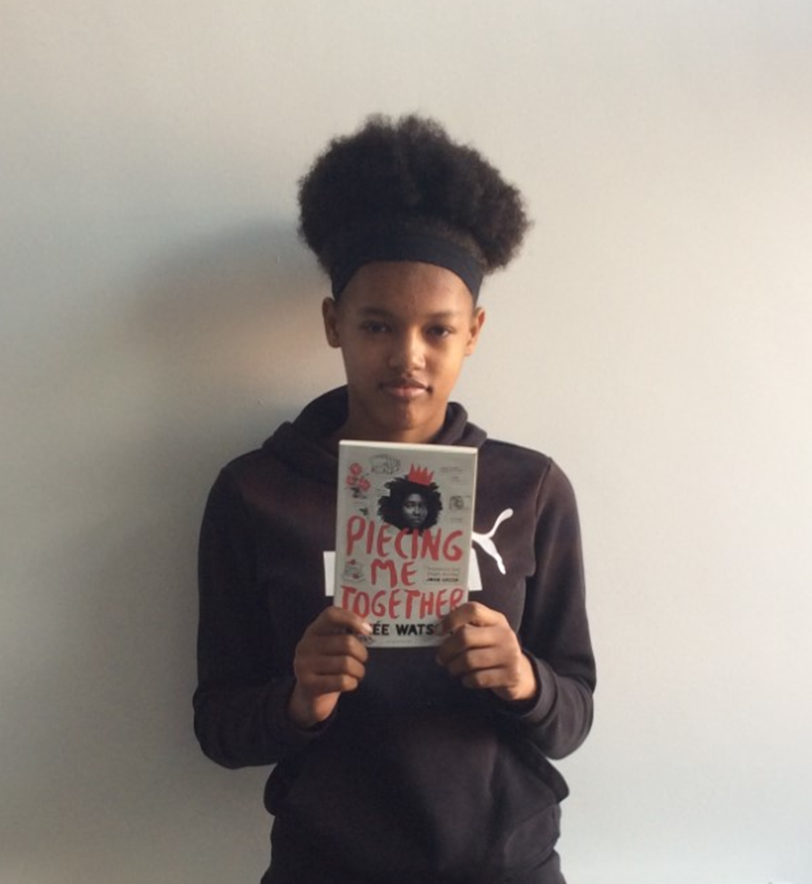
Tianna Woolley, Year 9
‘I found this book interesting because there are not that many black people who are known and written about. I can relate to some of the things in this book. I get a bus to school like the main character, Jade. She came from a poor background then got a scholarship to a posh white school to do art. Just because her mentor is black doesn’t mean she understands where Jade is coming from because she doesn’t know Jade’s background.
I lived with my mum then with my nan then back to mum’s. Where do I fit in?’

Slide 3
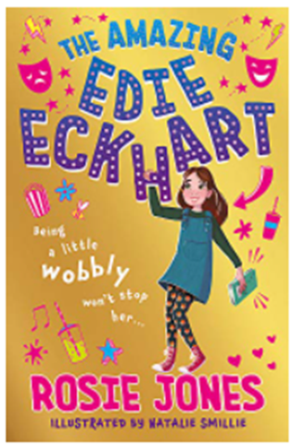
Year 5 child, Nottingham
‘A year 5 child came in with her mum to exclaim how relevant this text was for her as she has cerebral palsy and the character in this book keeps falling down! Just like her. They were thrilled to have been represented within this text.
She also has two mums and this is also the same as Eddie Eckhart, which was amazing!
This was a real celebration and has turned this child onto reading again as she can see herself and her life reflected - a real mirror!’

